Slide 1
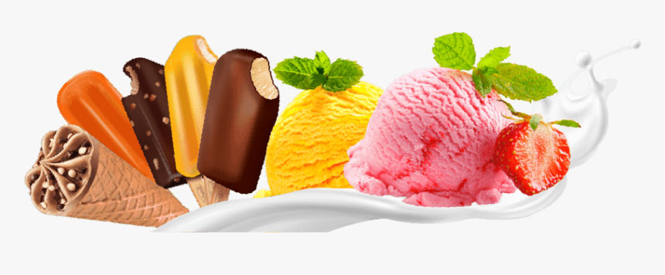
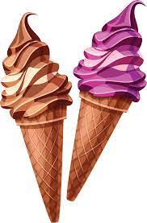
SIMULATION OF ICE CREAM SHOP

Slide 2
GROUP MEMBERS
Aaiza Irfan (SP20-BCS-001)
Kulsoom Khurshid (SP20-BCS-044)
Malaika Mubashir (SP20-BCS-048)

Slide 3
TOPICS INCLUDED
Semaphores
Deadlock handling
01
03
Thread synchronization
Time
02
04
Avoiding the blockage of processes.
Mechanism used to control the access of the resources.
Mechanism that ensures that no simultaneous thread execution takes place.
Declare time variable to know the time of execution

Slide 4
Semaphores
Semaphore is a variable that is non-negative and shared among the threads.
A semaphore is a signaling mechanism on which threads depend, and a thread that is waiting on a semaphore can be signaled by another thread.
It uses two atomic operations, Wait() and Signal() for the process synchronization.

Slide 5
DEADLOCK HANDLING
Deadlock is a situation where a process or a set of processes is blocked, waiting for some other resource that is held by some other waiting process. It is an undesirable state of the system. The following are the four conditions that must hold simultaneously for a deadlock to occur.
Mutual Exclusion
Hold and wait
No pre-emption
Circular wait

Slide 6

PROJECT DESCRIPTION
This project is a
demonstration of an ice cream
shop where each customer
gets to choose a flavor one
at a time. For this purpose,
semaphores are used.

Slide 7
System Diagram
01
Working of the code

Slide 8
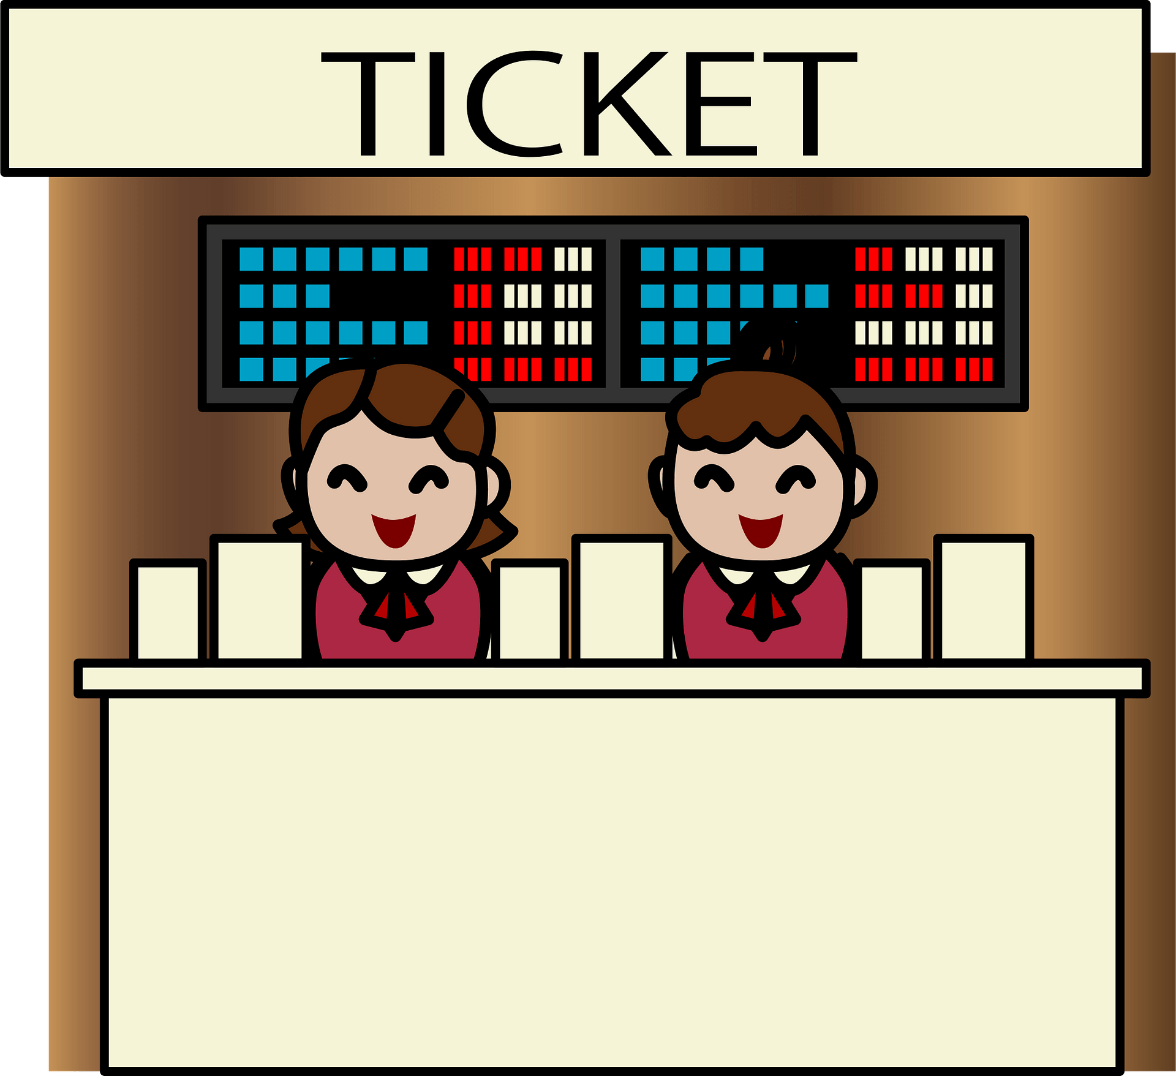

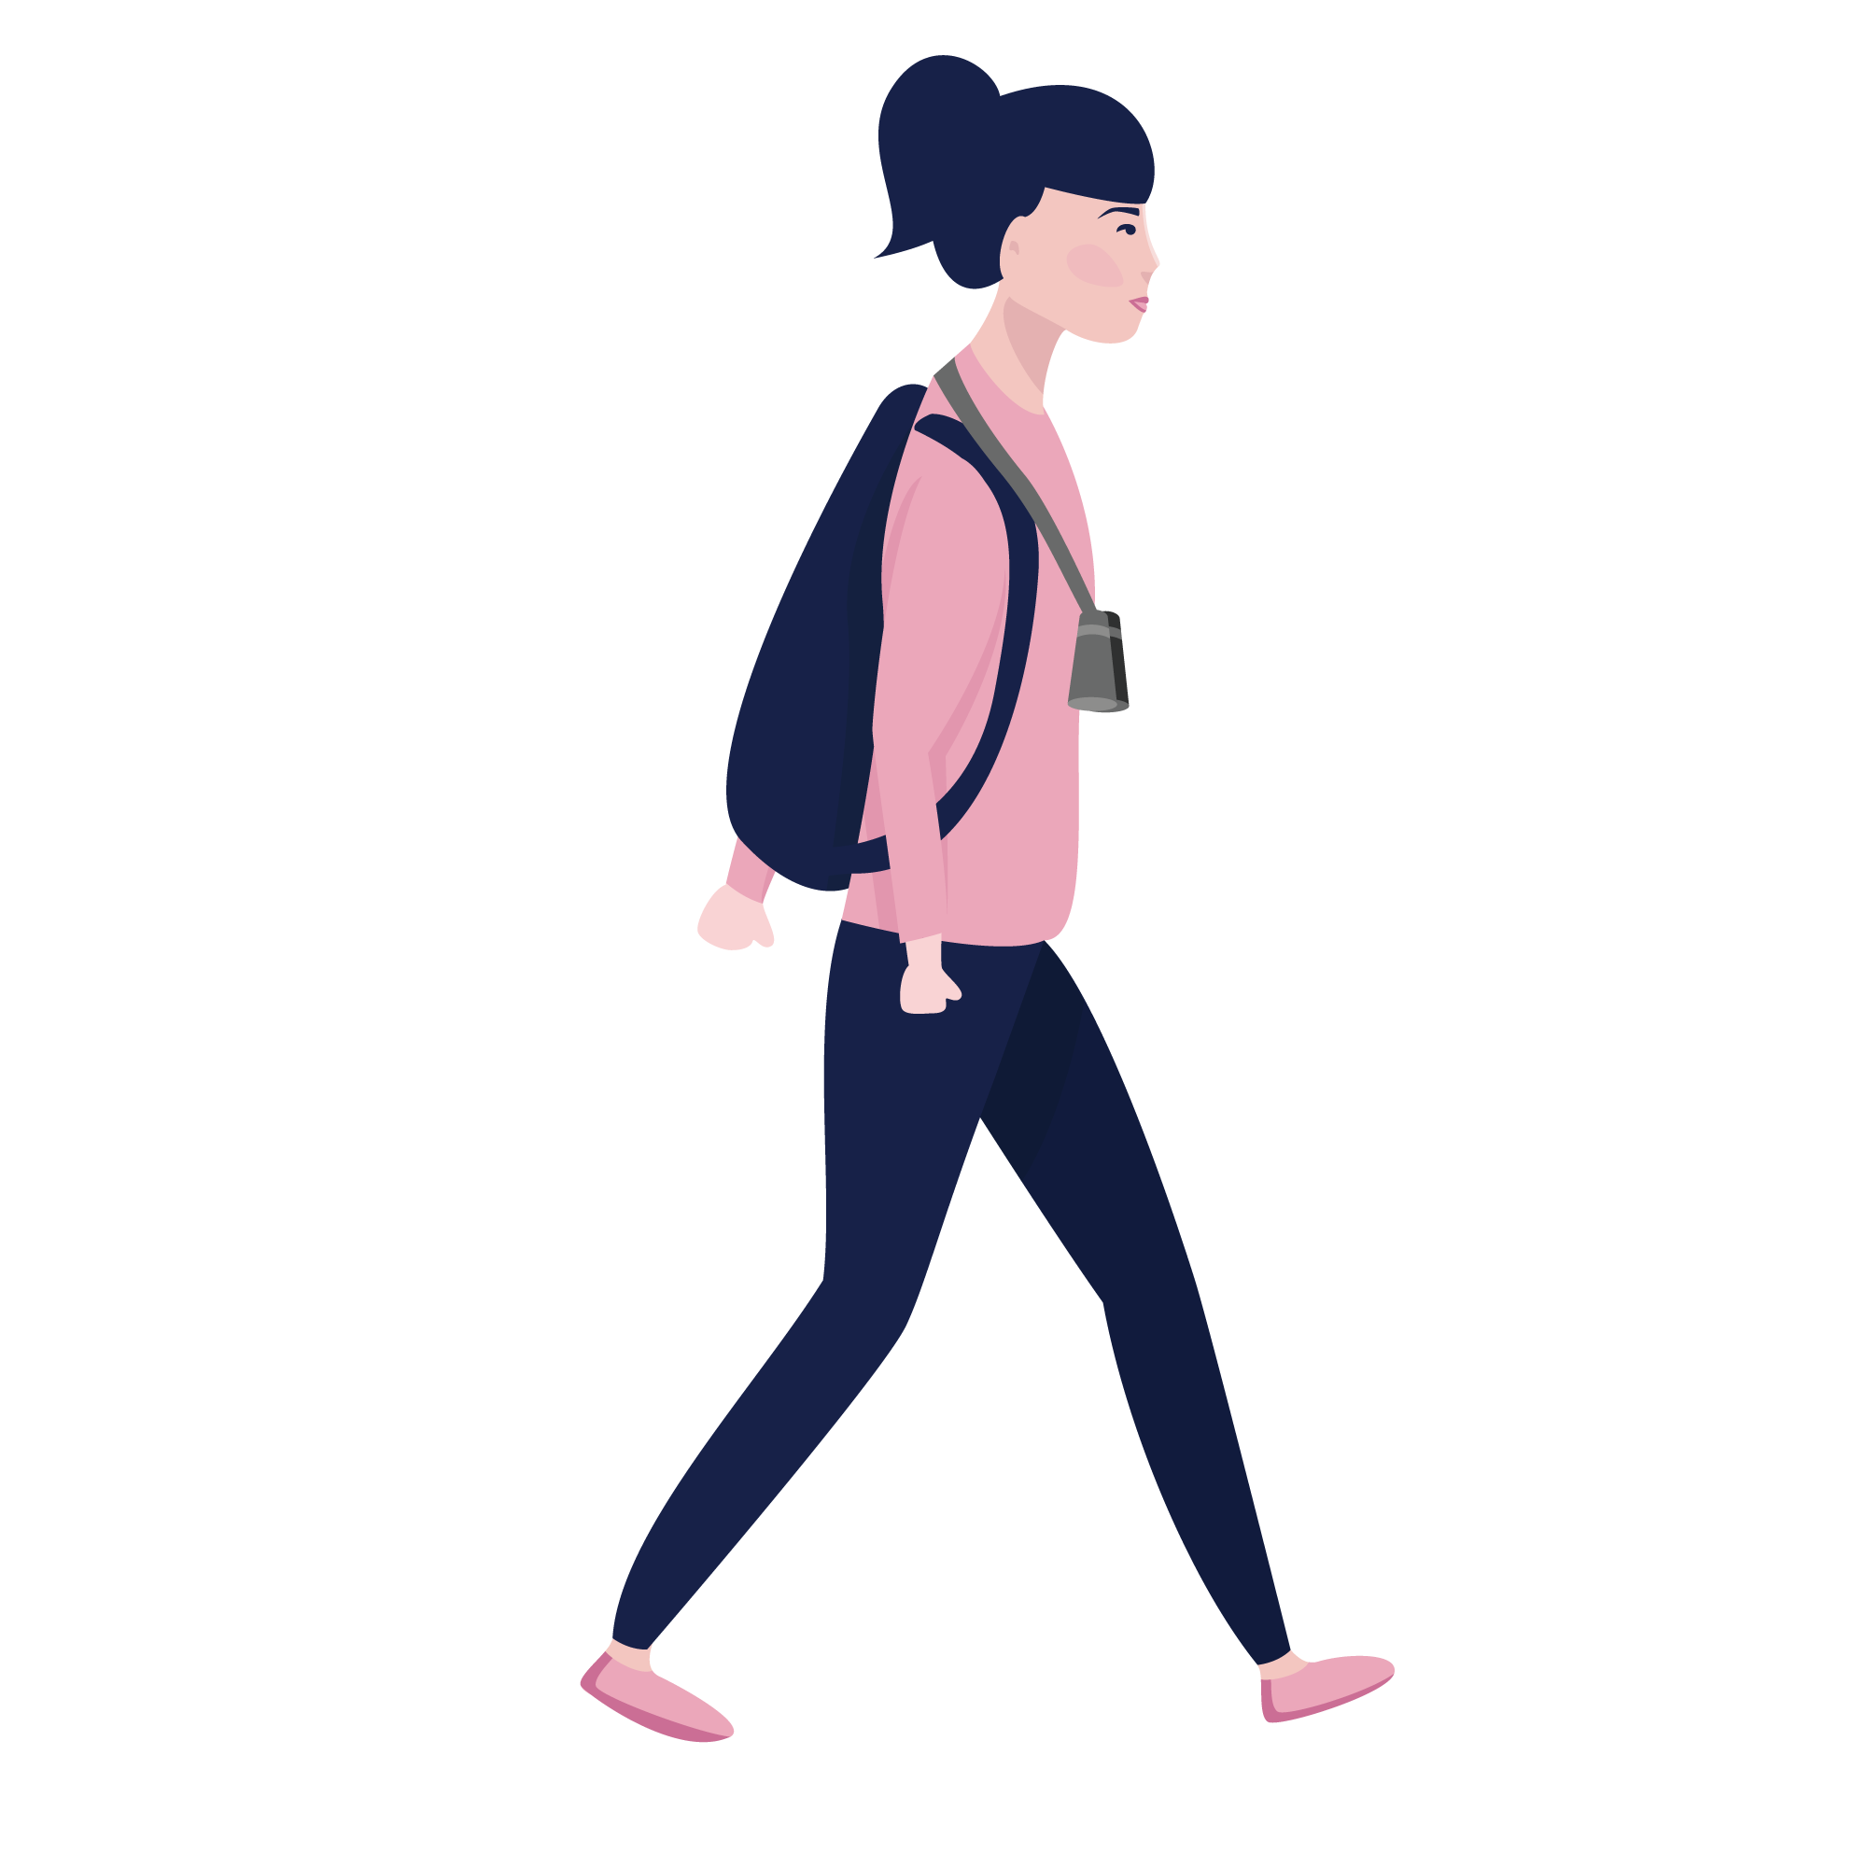

Customer 3 gets the ticket
Customer 3 choose the flavor
Customer 1 gets the ticket
Customer 1 choose the flavor
Customer 2 gets the ticket
Customer 2 choose the flavor

Slide 9
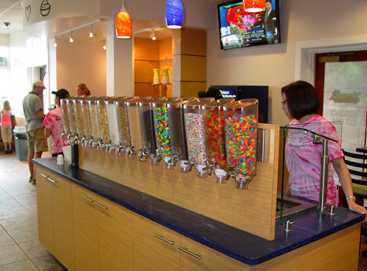

Customer 3 pays
Customer 1 pay
Customer 1 choose the toppings
Customer 2 pay
Customer 3 choose the toppings
Customer 2 choose the toppings

Slide 10
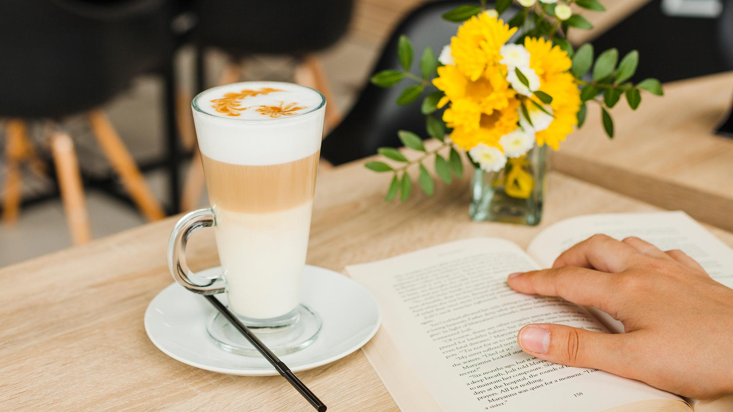
CODE

Slide 11
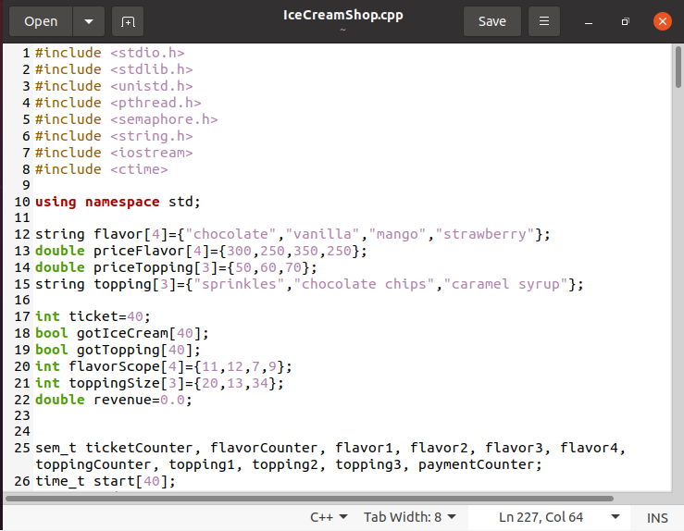
CODE (pt 1)

Slide 12
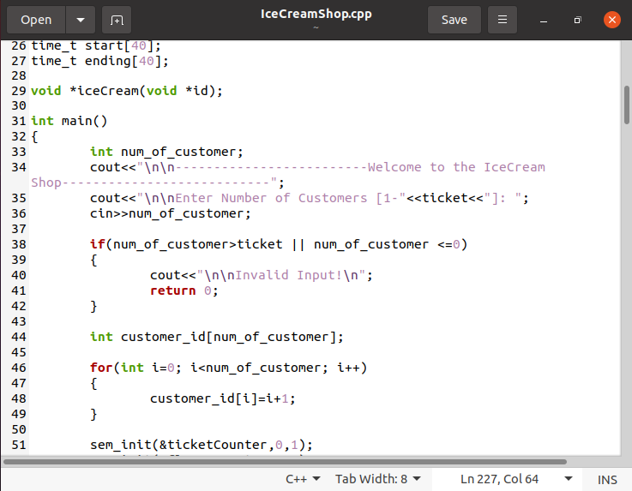
CODE (pt2)

Slide 13
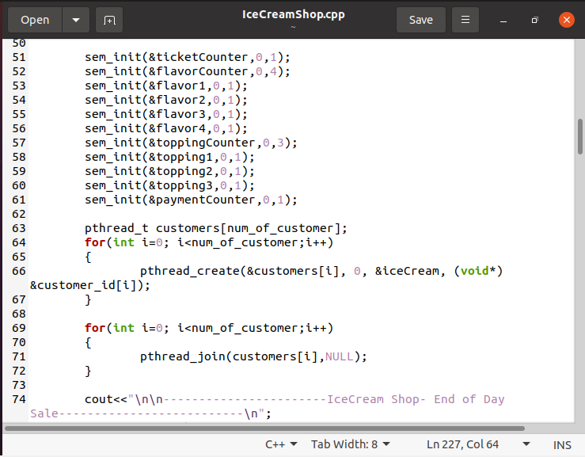
CODE (pt3)

Slide 14
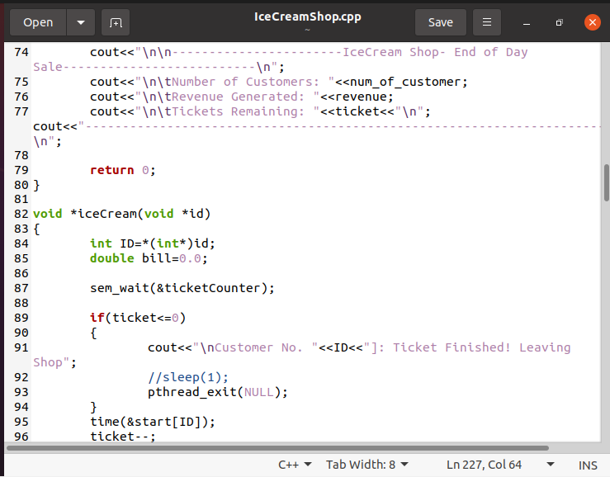
CODE (pt4)

Slide 15
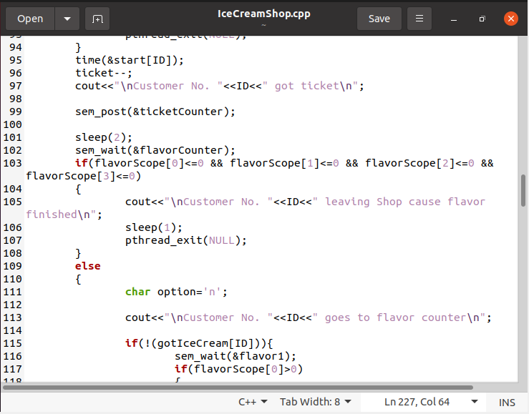
CODE (pt5)

Slide 16
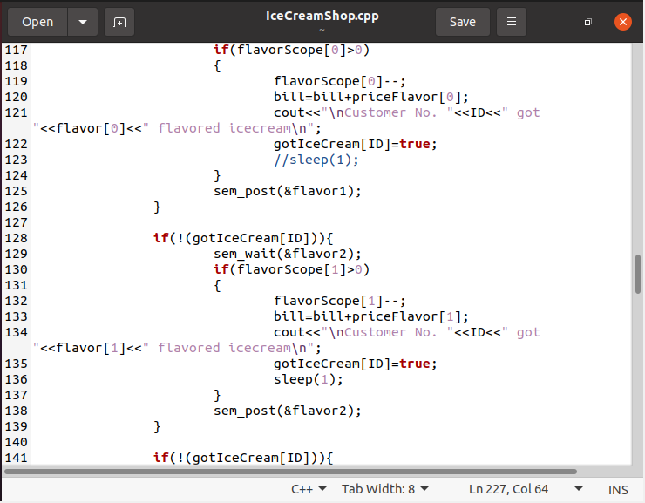
CODE (pt6)

Slide 17
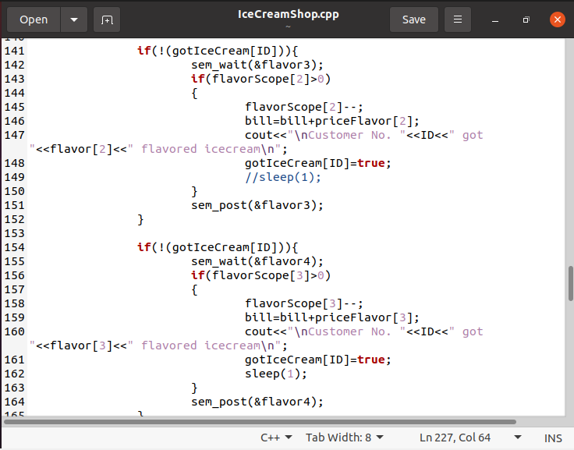
CODE (pt7)

Slide 18
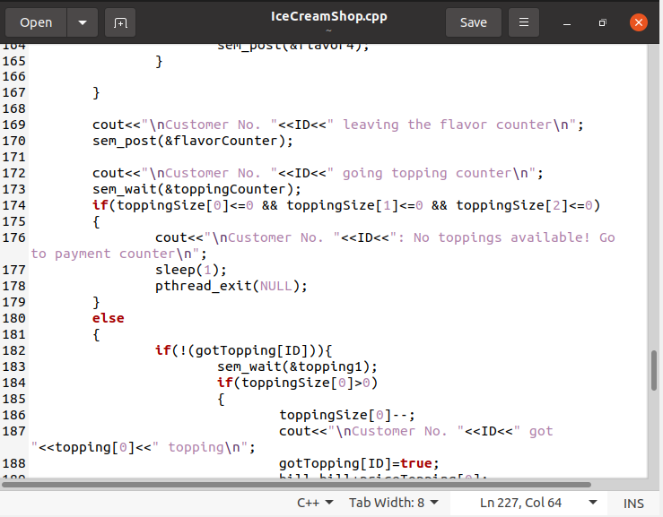
CODE (pt8)

Slide 19
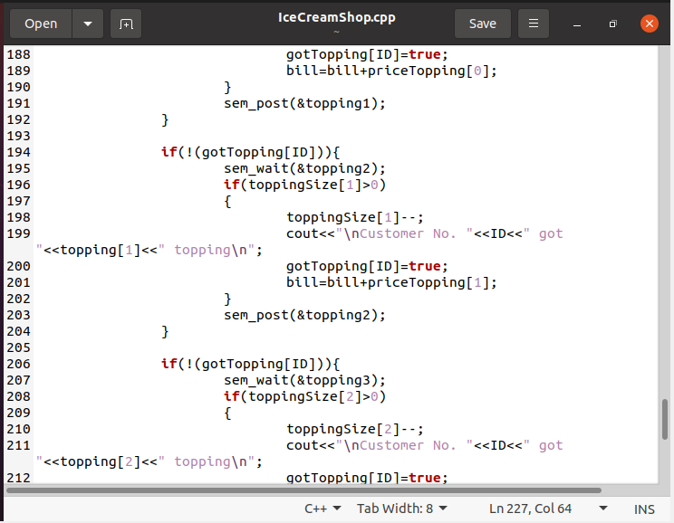
CODE (pt9)

Slide 20
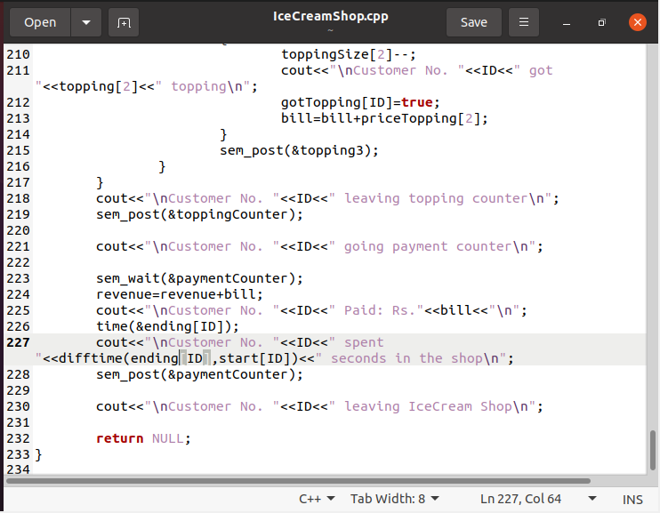
CODE (pt10)

Slide 21
OUTPUT

Slide 22
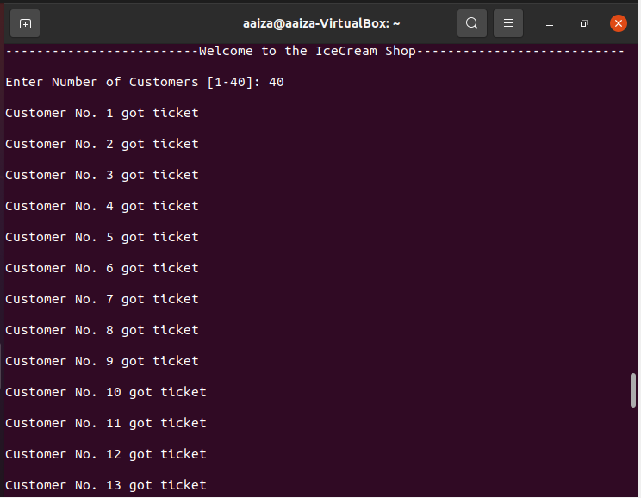
Output (pt1)

Slide 23
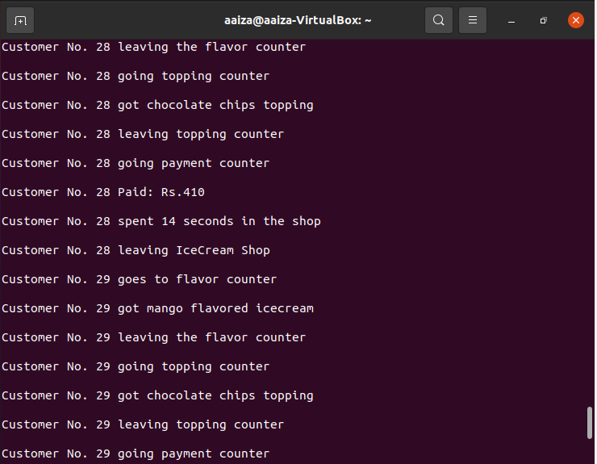
Output (pt2)

Slide 24
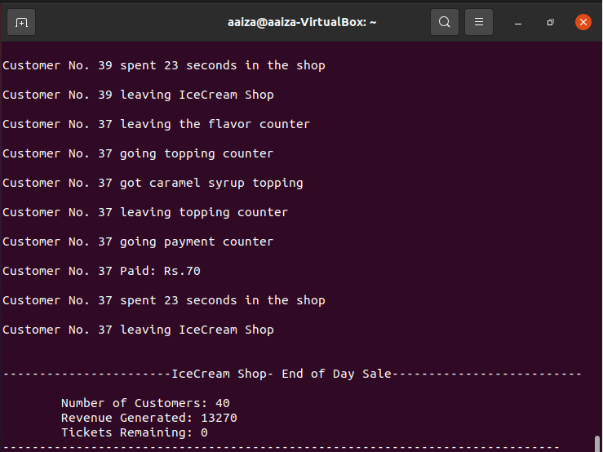
Output (pt3)

Slide 25
THANK YOU! Any Question?

